Slide 1
What is Autism Spectrum Disorder
Staff Training Manual – Series – Part 1
Created by: Shayna Gaunt, BCBA
How to ABA

Slide 2
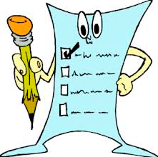
Pre-Test
What does ASD stand for?
How many levels of ASD does the DSM-V specify?
Autism can be characterized behavioral ________ and behavioral deficits
Autism is characterized by deficits in _______, ________, and ______.
True or False:
Autism used to be classified as Schizophrenia
Autism is a spectrum, ranging from mild to severe
Boys are 4x more likely than girls to be diagnosed with autism
Causes of autism include older parents
More than 50% of children with autism have chronic sleep problems
Some people with autism also have ADHD and/or anxiety

Slide 3
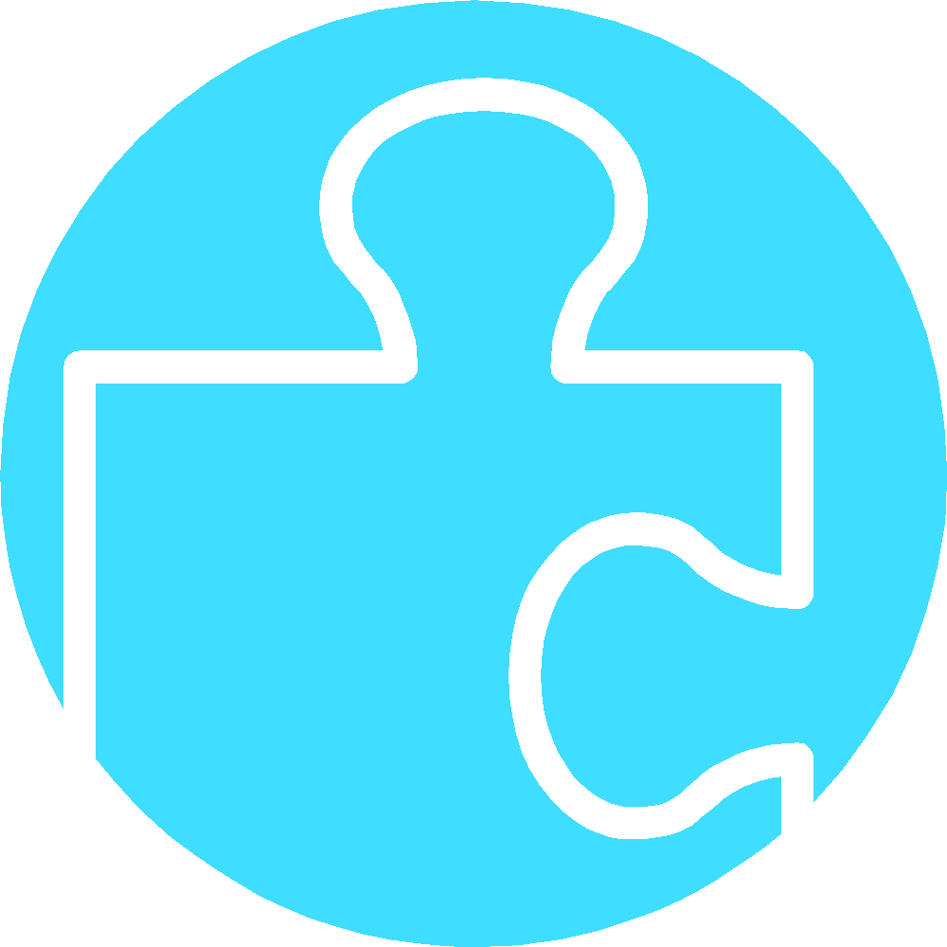
Autism – Historical Background
1943 – Leo Kanner differentiated Autism from childhood Schizophrenia
1950’s/60’s – Bruno Bettelheim – Refrigerator mom theory
1970’s – Bernard Rimland – Autism is neuro-biological
1966 – Ivar Lovaas 1st used the behavior analytic approach in UCLA for autism treatment
1987 – Lovaas published a study documenting the success of this treatment
1990’s – ABA widely used in the US for the treatment of ASD
2013 – DSM 5 updated the status of ASD
2018 – Insurance companies cover ABA in all US states
Alpine Learning Group, Inc.

Slide 4

What is Autism
Ideas??
Notes:
Behavioural Excesses
Splinter skills
Disruptive Behaviour
Stereotypic Behaviour
Repetitive Behaviour
Behavioural Deficits
Language and communication
Social and emotional
Perspective taking
Lack of age appropriate play skills
Inflexibility to change routines
Lack of joint attention

Slide 5
Autism is…
A developmental disorder
A spectrum – mild to severe
DSM V:
  Deficits in language, social, behavior
  3 levels
https://www.autismspeaks.org/what-autism/diagnosis/dsm-5-diagnostic-criteria

Slide 6
DSM V (2013)
Diagnostic and Statistical Manual of Mental Disorders – Version 5 – 2013
Autism Spectrum Disorder (ASD) merged 4 previously distinct diagnosis into 1:
  Autism
  Childhood Disintegrative Disorder
  Pervasive Developmental Disorder NOS
  Asperger Syndrome

Slide 7
3 Levels of Severity – Level 1
Level 1 – “Requiring support”
  Typically speaks in full-sentences
  Social deficits
    Difficulty initiating and maintaining conversation
    Non-verbal cues can be difficult
  Inflexibility of behavior
    Difficulty switching between activities
  Problems with organization and planning
DSM V

Slide 8
3 Levels of Severity – Level 2
Level 2 – ”Requiring substantial support”
  Language impairments – speaks in short phrases
  Social impairments
  Narrowed interests
  Difficulty coping with change
  Restricted repetitive behaviors
DSM V

Slide 9
3 Levels of Severity – Level 3
Level 3 – “Requiring very substantial support”
  Severe deficits in verbal and nonverbal social communication
  Limited initiations of social interaction
  Severe language delays
  Inflexibility of behavior
  Extreme difficulty coping with change
  Restricted/Repetitive behaviors that markedly interfere with functioning
  Great distress changing focus
DSM V

Slide 10
Behavioral Excesses
Disruptive Behavior
  Tantrums, non-compliance, physical aggression, self-injury
Stereotypic Behavior
  Visual, auditory, olfactory, tactile, proprioceptive, rituals
Splinter Skills
  Hyperlexia, superior rote memory, affinity towards numbers

Slide 11
Behavioral Deficits
Impaired Language
  Mutism, echolalia, inappropriate inflection, volume, and content
  Receptive understanding and expressive output
Social and Emotional
  Avoidance or escape from social interactions and physical contact, lack of response to fear-evoking stimuli, displaying flat or non-contextual affect such as inappropriate laughter or crying
Attention
  Ability to stay on task for an appropriate amount of time, short attention to task, poor eye contact

Slide 12
Behavioral Deficits
Deficits in Play
  Interactive, symbolic, pretend, peer play)
Abnormal Responses to Sensory Stimulation
  Visual, auditory, tactile
Stimulus Over-Selectivity
  Circumlocution—attending to a specific part of a stimulus rather than to the stimulus as a whole
Cognitive Deficits
  Mental retardation, regressing of acquired skills, scattered learning curves

Slide 13
Impaired Social Development
Failure to initiate or respond to conversation
Inability to read non-verbal cues (gestures, idioms, etc.)
Reduced sharing of interests, emotions, affect
Poor eye contact, body language, facial expressions
Difficulty in imaginative play, making friends, adjusting behavior to suit various social context

Slide 14
Restricted, Repetitive Behavior
Restricted interests, activities
Perseveration on topics, fixated interests
Sometimes rigid, inflexible
Insistence on sameness
Stereotypic behavior (“Stimming”)
Hyper/Hypo-activity to sensory input
Can affect executive functioning/organization

Slide 15
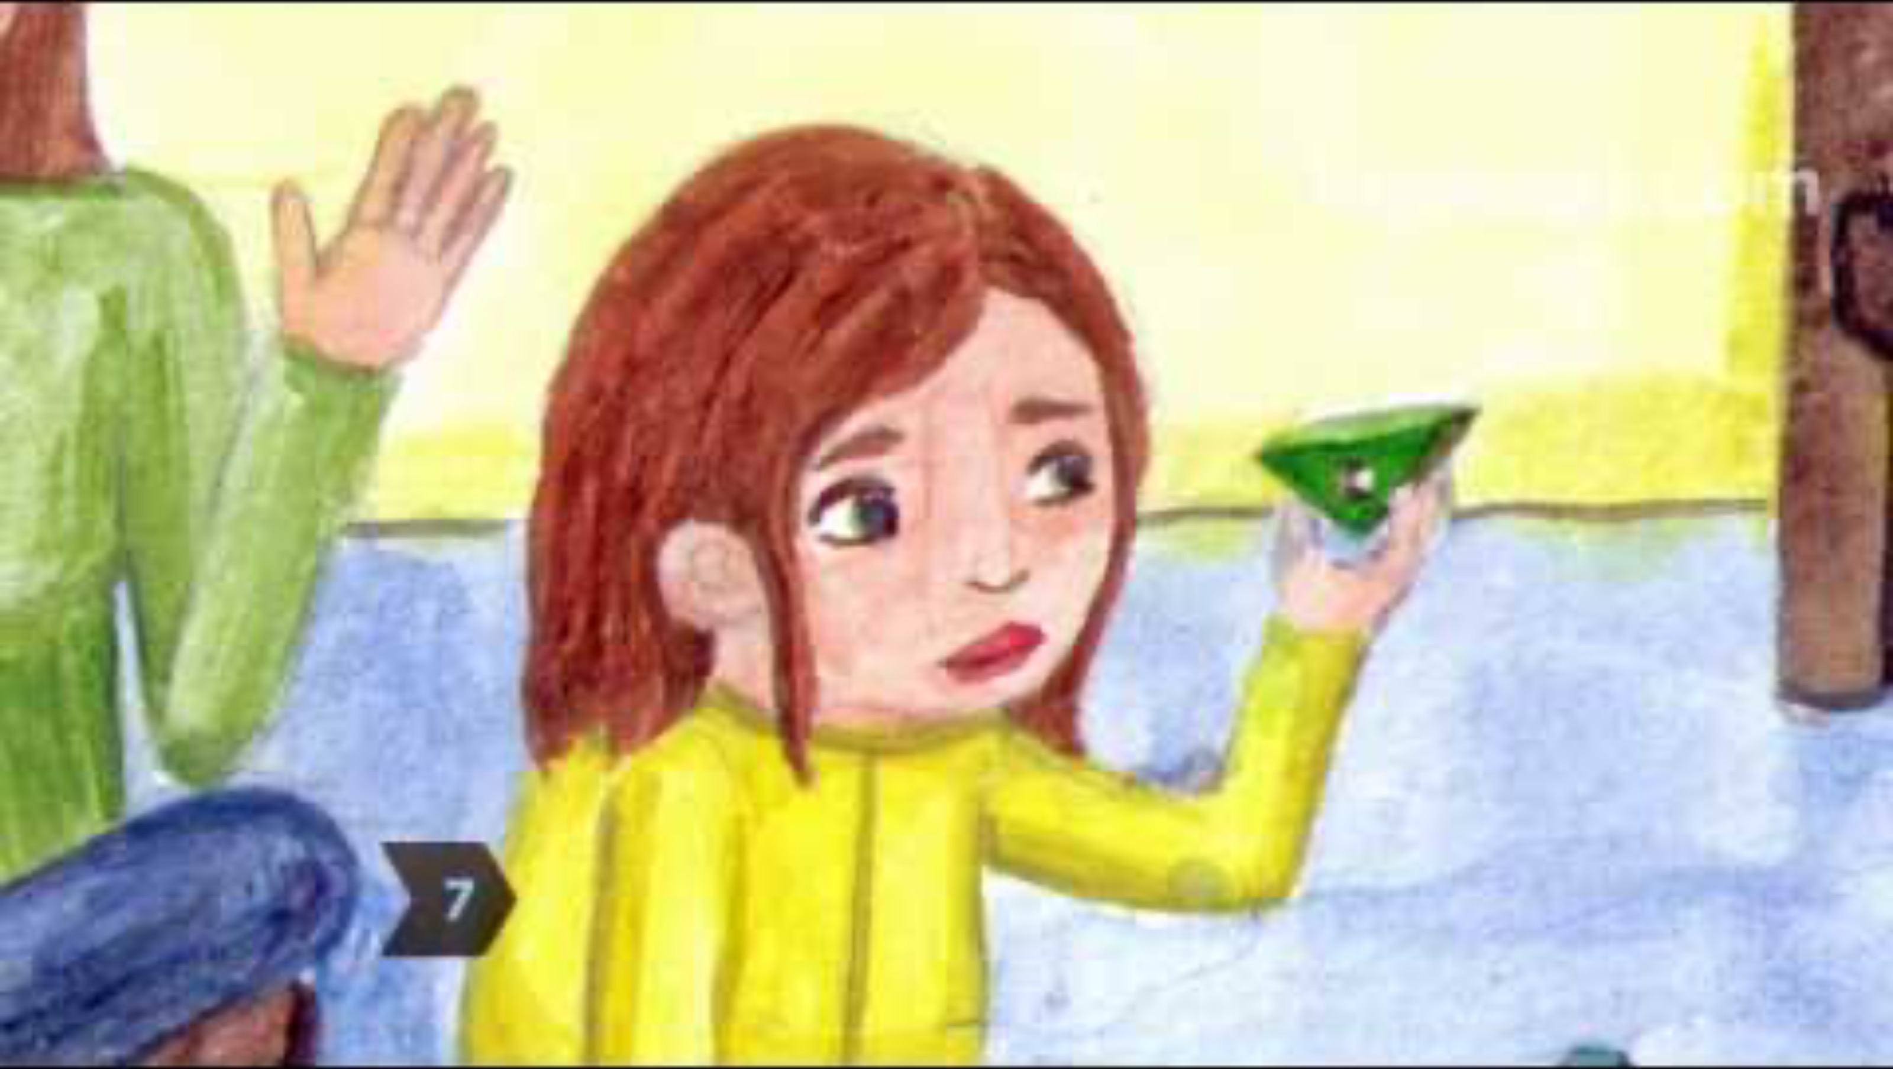
Video

Slide 16
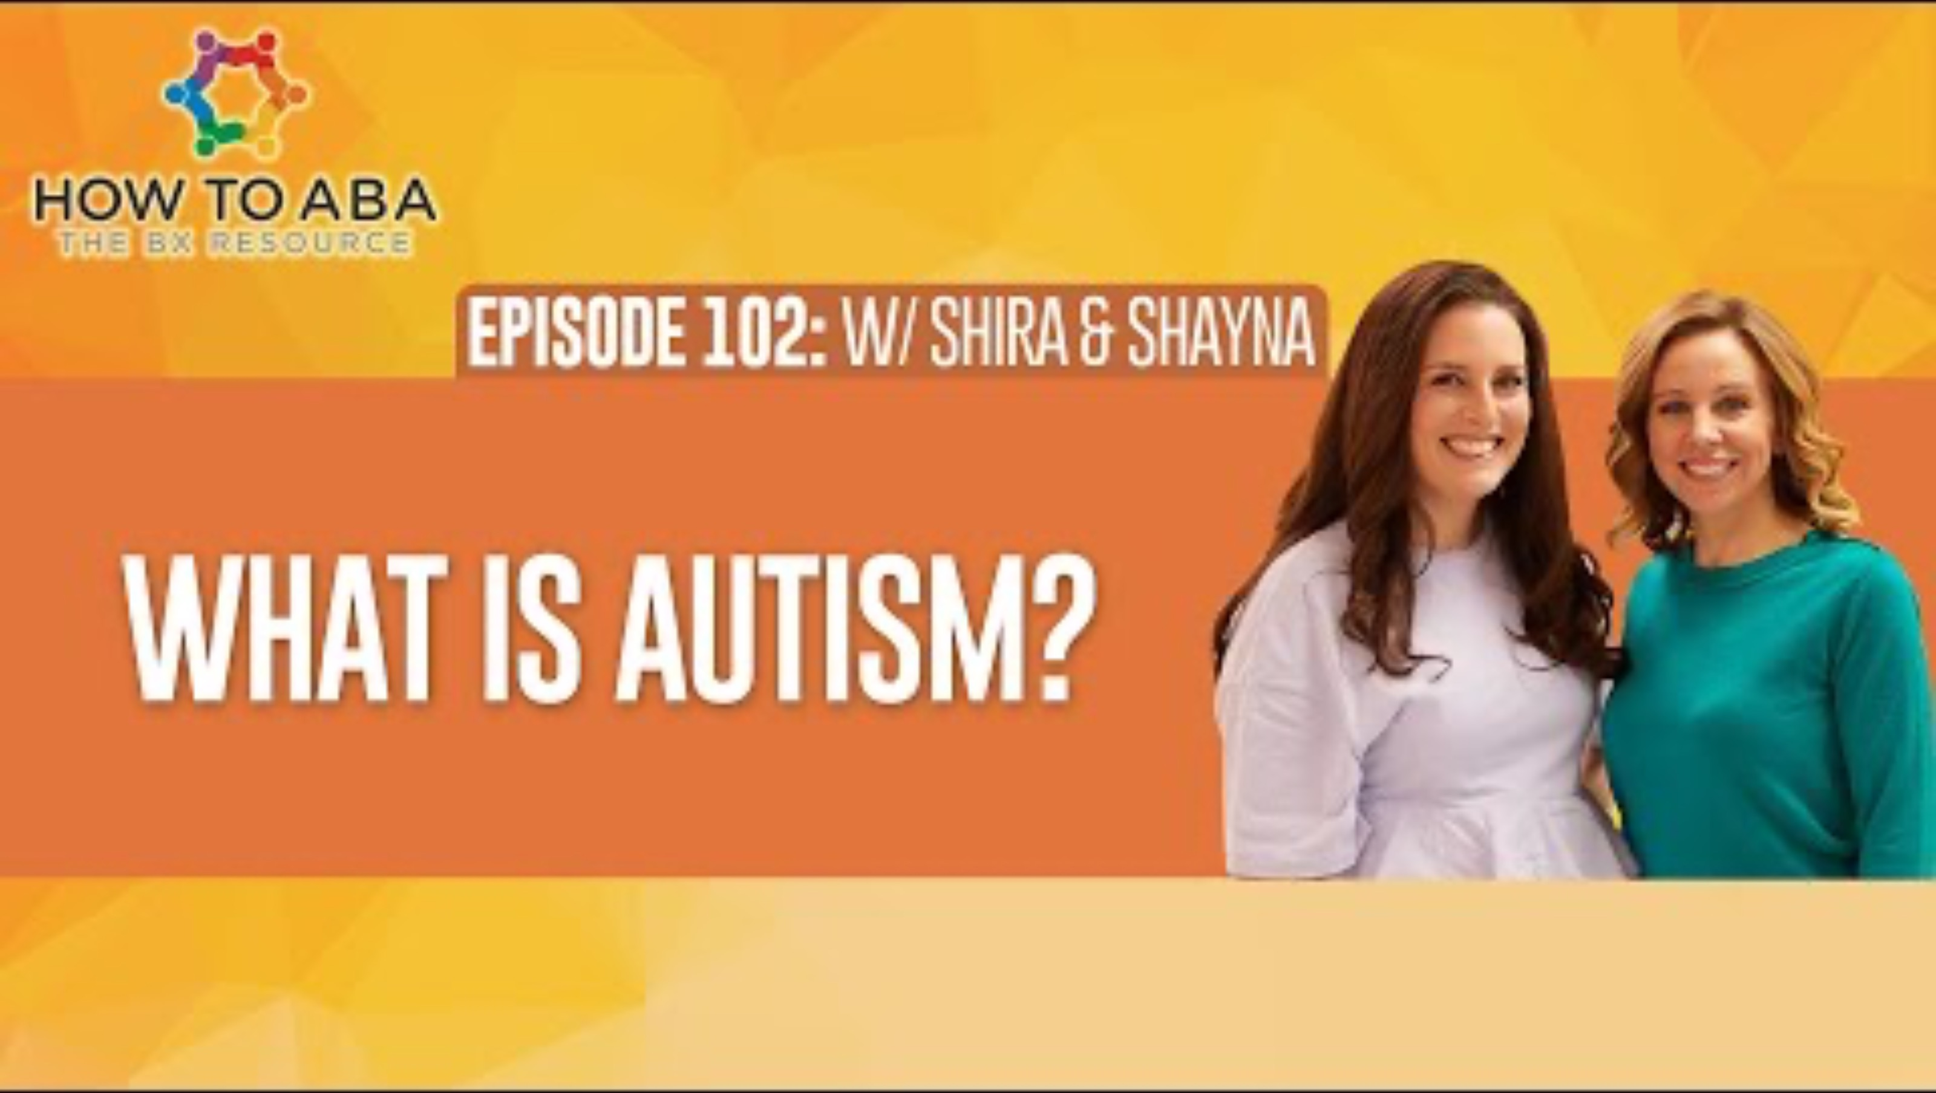
Video

Slide 17
Autism Prevalence
1 in 54 children in USA diagnosed with ASD (2020, CDC)
  1 in 34 boys identified with autism
  1 in 144 girls identified with autism
Boys are four times more likely to be diagnosed with autism than girls.
Autism ranges from mild to severe:
  44% have IQ scores in the average to above average range (i.e., IQ >85)
  25% are in the borderline range (IQ 71–85)
  31% of children with ASD have an intellectual disability (intelligence quotient [IQ] <70)
Autism affects all ethnic and socioeconomic groups.
Early intervention affords the best opportunity to support healthy development and deliver benefits across the lifespan.
There is no medical detection for autism.
https://www.autismspeaks.org/autism-statistics-asd

Slide 18
Causes of Autism Spectrum Disorder
Research indicates:
  Genetics are involved in the vast majority of cases.
  Children born to older parents are at a higher risk for having autism.
  Parents who have a child with ASD have a 2 to 18 percent chance of having a second child who is also affected.
  Among identical twins, if one child has autism, the other will be affected about 36 to 95 percent of the time.
  In non-identical twins, if one child has autism, then the other is affected about 31 percent of the time.
  Vaccines do not cause autism.
https://www.autismspeaks.org/autism-statistics-asd

Slide 19
Associated Health Conditions
30-61% also have Attention Deficient Hyperactivity Disorder (ADHD)
More than 50% have chronic sleep problems
11-40% are also affected by anxiety disorders
Depression affects an estimated 7% of children and 26% of adults with autism
Chronic gastrointestinal disorders are 8x more likely in children with ASD
1/3 of people with autism have epilepsy (seizure disorder)
Schizophrenia affects 4-35% of adults with autism.
  (Schizophrenia affects an estimated 1.1 percent of the general population)
1/3 of 2–5-year-old's with ASD are overweight; 16% are obese.
  (23% of 2-5-year-old’s in the general population are overweight; 10% medically obese)
Autism-associated health problems extend across the life span
  From young children to senior citizens.
https://www.autismspeaks.org/autism-statistics-asd

Slide 20
Treatment
Applied Behavior Analysis (ABA) is one of the only scientifically valid treatments for autism
Treatment should begin young because the plasticity of the young brain allows for greater progress
There is not any known cure for this life-long disorder. However, some individuals show significant progress with treatment.
  Progress varies greatly among individuals
  Some may even become indistinguishable from typically developing peers
Note: ABA is not conversation therapy – ABA strives to enhance lifestyle, not change an individual
https://www.autismspeaks.org/autism-statistics-asd

Slide 21
Non-Scientific Treatments
(No data to support the acquisition of skills and the reduction of autistic tendencies)
Sensory Integration
Floor Time (Greenspan)
Facilitated Communication
Music Therapy
Play Therapy
Dolphin Therapy
Etc.
** It is important to question treatments based on what we know about autism (i.e., that it is diagnosed in terms of behavioral deficits and excesses)

Slide 22

Questions/Comments/Discussion

Slide 23
References
American Psychiatric Association. (2013). Diagnostic and statistical manual of mental disorders (5th ed.)
https://www.autismspeaks.org
https://www.mayoclinic.org/diseases-conditions/autism-spectrum-disorder/symptoms-causes/syc-20352928
https://www.cdc.gov/ncbddd/autism/facts.html

Slide 24
Post-Test
What does ASD stand for?
How many levels of ASD does the DSM-V specify?
Autism can be characterized behavioral ________ and behavioral deficits
Autism is characterized by deficits in _______, ________, and ______.
True or False:
Autism used to be classified as Schizophrenia
Autism is a spectrum, ranging from mild to severe
Boys are 4x more likely than girls to be diagnosed with autism
Causes of autism include older parents
More than 50% of children with autism have chronic sleep problems
Some people with autism also have ADHD and/or anxiety

